Slide 1
Chief Cook & Bottle Washer
A recipe database for the efficient chef in everyone

Slide 2
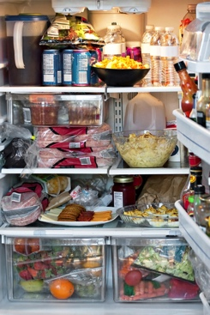
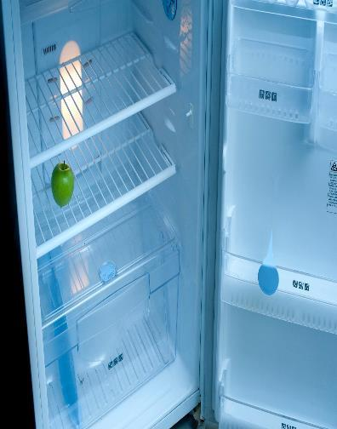
or

Slide 3
[cod,
tomatoes,
broccoli,
bacon,
a lot of bacon]
=

Slide 4
Scrape, scrape, scrape…

Slide 5
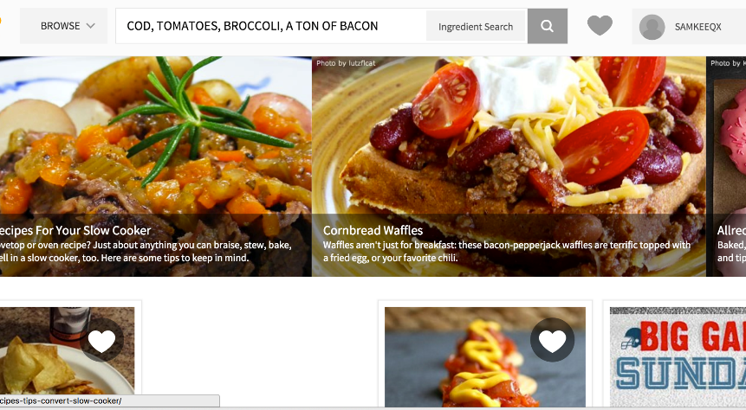
Returns: a list of recipes that use a combination of the ingredients listed

Slide 6
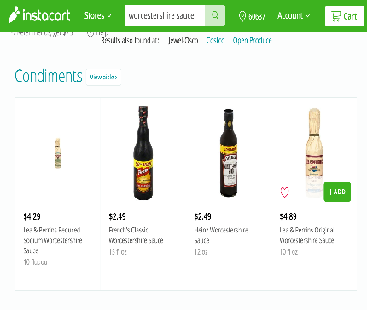
Part II: What if I don’t have Worcestershire sauce?
Our Website

Slide 7
Data Sources
Will scrape 3 recipe sites with the most visitor traffic in 2015:
Allrecipes.com
Foodnetwork.com
Food.com
Will fill out forms on Instacart.com

Slide 8
Work plan – Part I
Index recipes using BeautifulSoup
Use a dictionary to store information
{peas: set([url1, url2, url6])
beef: set([url3, url6])
onions: set([url4, url5])}
If user has peas and beef, return url6

Slide 9
Work plan – Part II
Autofilling Instacart
Use Python’s Request or Mechanize to log into Instacart and populate with missing ingredients
Will use a personal Instacart account for project’s purpose

Slide 10
Work plan – Website
Website will be built using Django.

Slide 11
Timeline
4th Week
Figure out exact steps to index websites (Sam)
and autofill Instacart (Alvin)
5th and 6th Week
Start indexing websites (both)
Write code to return relevant recipes (Sam)
Write code to autofill Instacart (Alvin)
Test code with a fake index

Slide 12
Timeline
7th Week
Index and code should be finished
Work on web interface using Django (both)
8th Week
Meet-up with Prof to troubleshoot and finalize the prototype
Continue working on web interface (both)

Slide 13
Potential Issues
Recipe website might not list all available recipes via inter-connected links
Is a dictionary the best way to handle a large dataset? Maybe SQL?

